Slide 1
A combined Approach for Koopman Operator Approximation
Presented by:
Alexander Estornell, Alena Spiro

Slide 2
Motivation
Often we desire to analyze systems.
State prediction: Want to know long term behaviors of weather patterns
System design: Understand turbulence to reduce drag on a race car
Path planning: Understand the trajectories of robots
Interpretability: Provide intuition and understanding for physical phenomenon

Slide 3
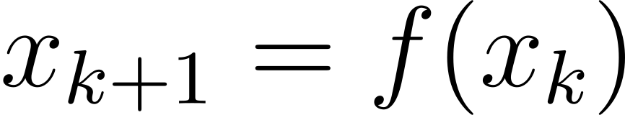
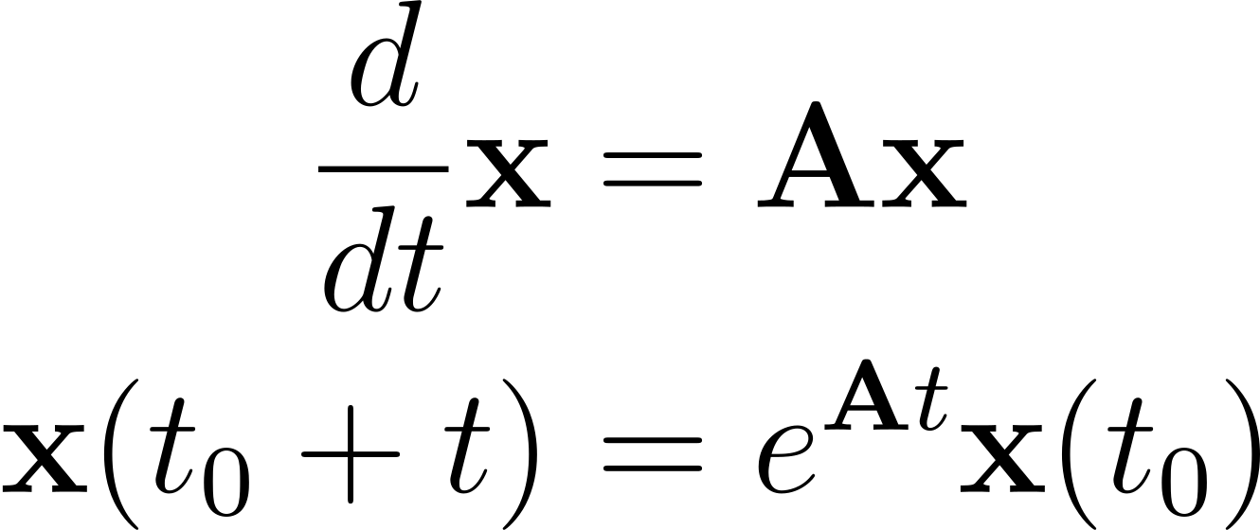

Statement of the Problem
Given a dynamical system of the form
Where is unknown. we desire to effectively model , given a set of trajectories.
Incredible analysis can be applied to linear systems. Unfortunately nonlinear systems are not always easy to work with!

Slide 4
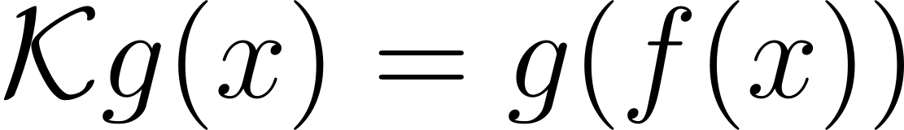
Towards a Solution (Koopman Operators)
Fortunately, for deterministic discrete systems, there exists a coordinate transform on your states to a linear system.
Unfortunately, this linear operator is infinite dimensional.
Finite approximation?
  A basis of eigenfunctions of the Koopman allows for an exact finite approximation!

Slide 5
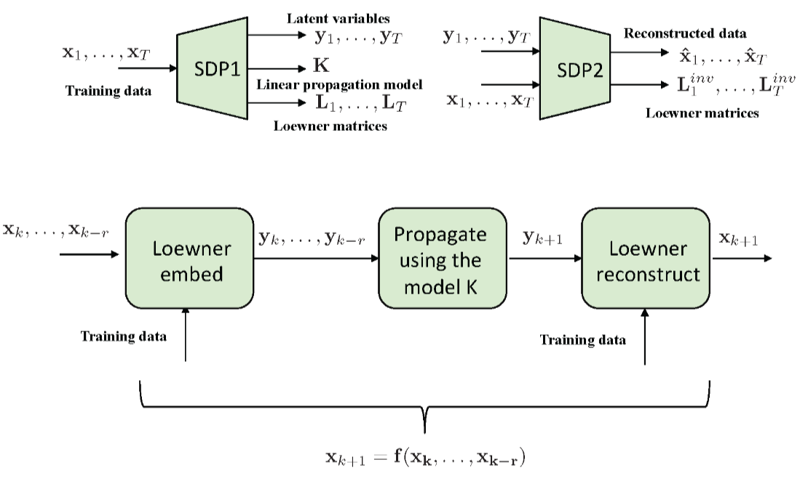
Programmatic Methods (SDPs)
Solve two SDPs to model system
  Represents observables as rational
  functions embedded in a Loewner matrix
Pros:
  able to find Koopman and learn
  the dimension of the embedding
  through kernel trick
Cons:
  SDPs are expensive to compute and
  scale poorly as data grows.
Sznaier, Mario. "A convex optimization approach to learning Koopman operators." arXiv preprint arXiv:2102.03934 (2021).

Slide 6
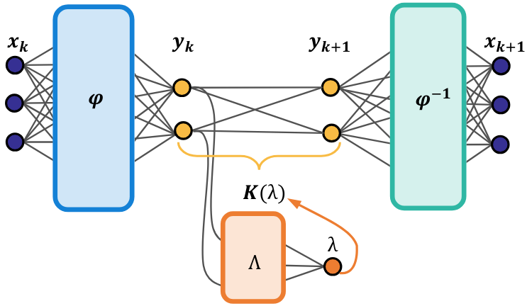
Learning Methods (DNNs)
Models the system as a NN
  Autoencoder structure that finds
  Koopman and observable mappings
  Through encoder/decoder capturing the
  span of eigenfunctions of K
Pros:
  Computationally efficient, able to handle
  Massive data sets
Cons:
  Requires prespecification of key system
  properties such as dimension of finite representation.
  (If it doesn’t include span of eigenfunctions, performance suffers)
Lusch, Bethany, J. Nathan Kutz, and Steven L. Brunton. "Deep learning for universal linear embeddings of nonlinear dynamics." Nature communications 9.1 (2018): 4950.

Slide 7
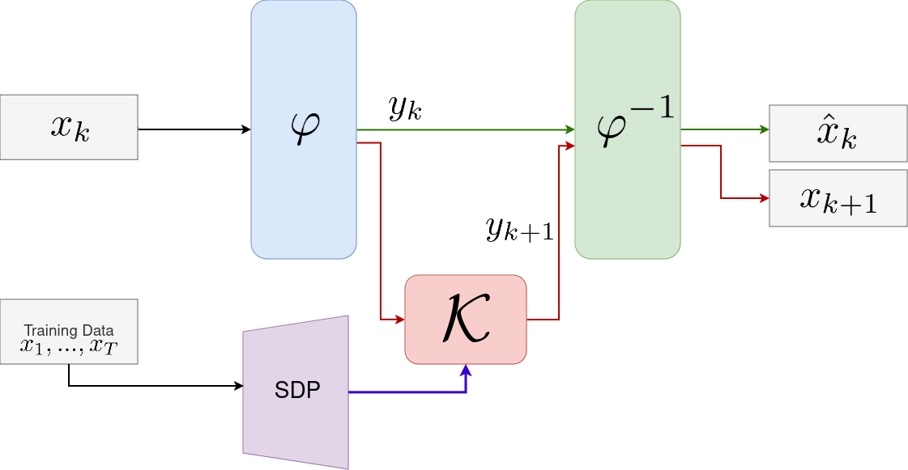
Contribution
Propose a method to combine
previous approaches in a way to
maintain accuracy and efficiency
Pros:
  Is able to capture key model properties
  and K through the solving of a single SDP
  Can learn observable mappings efficiently
  through NN using all data available.

Slide 8
Contribution
We solve an SDP using a kernel trick to determine dimensionality of observable space and an estimate of K
Use the dimension and K estimate to construct a NN to learn latent space that spans eigenfunctions of K
Freeze the parameters of K until learning slows down, then allow network to learn K to better the approximation found by SDP

Slide 9
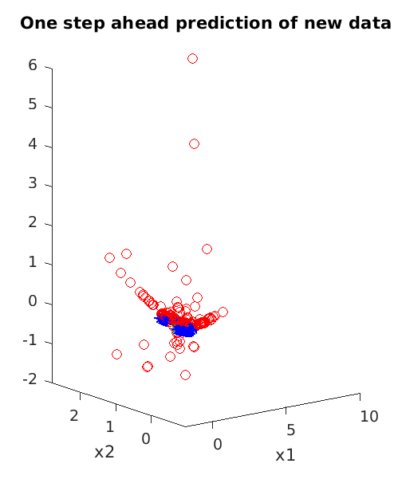
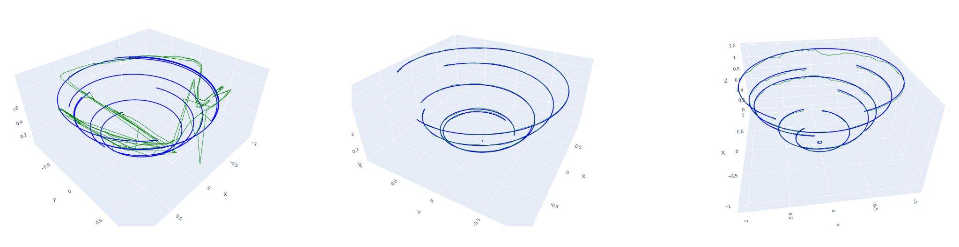
Results: Fluid Flow On Attractor
3-Network Without Koopman Hot-Start
3-Network With Koopman Hot-Start
2-Network with Koopman Hot Start
Double-SDP
Our systems vastly outperformed the network without the hot-start

Slide 10
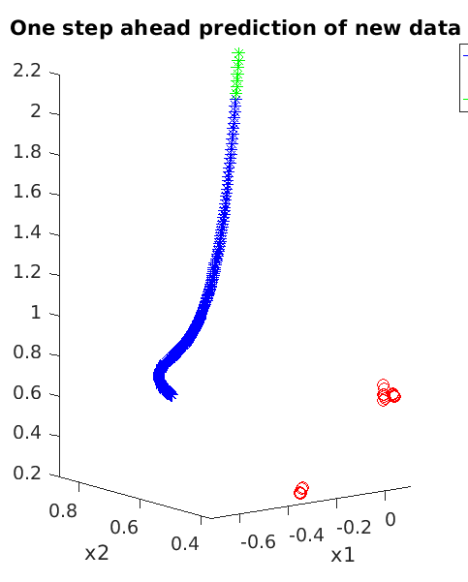
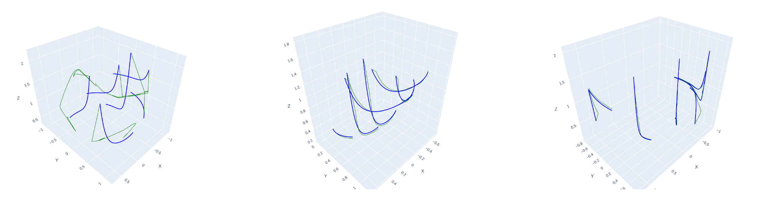
Results: Fluid Flow Box
3-Network Without Koopman Hot-Start
3-Network With Koopman Hot-Start
2-Network with Koopman Hot Start
Double-SDP
Our systems vastly outperformed the network without the hot-start

Slide 11
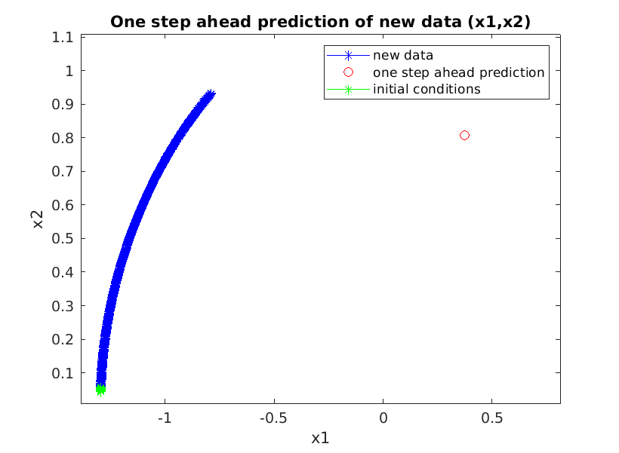
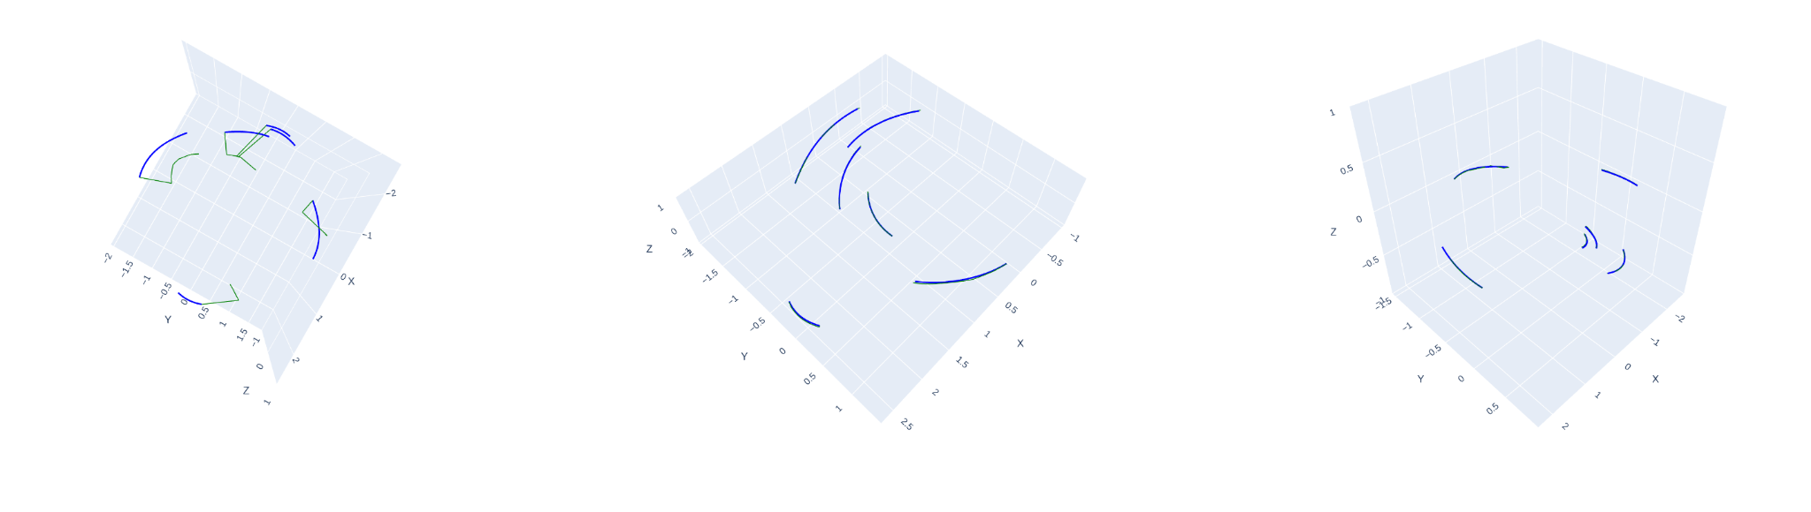
Results: Pendulum
3-Network Without Koopman Hot-Start
3-Network With Koopman Hot-Start
2-Network with Koopman Hot Start
Double-SDP
Our systems vastly outperformed the network without the hot-start

Slide 12
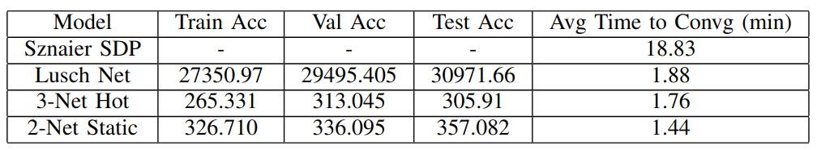
Results: 1-Step Accuracy and Time
Sznaier’s SDP implementation could not be compared due to its incompatibility with large datasets.
For the 3-Network Hot Start and 2-Network Static Koopman Methods, add ~9 minutes to get the Koopman operator.

Slide 13
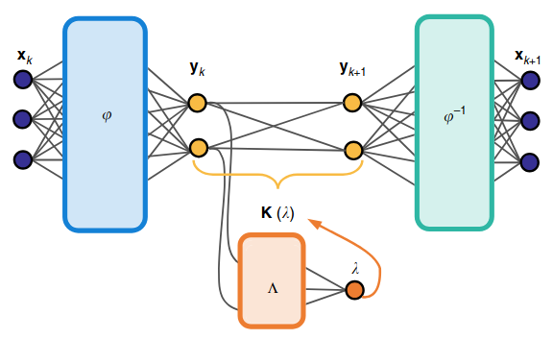
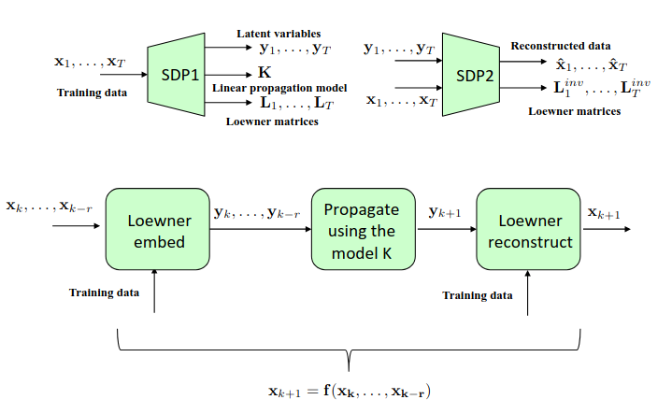
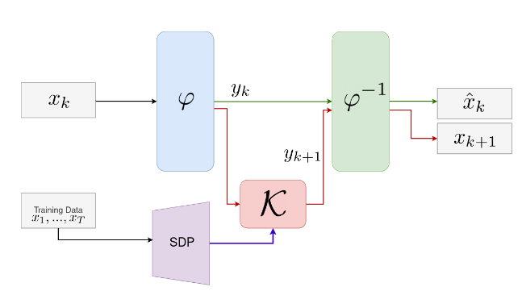
Conclusion
Our hybrid methods were able to vastly outperform both baseline models in performance and speed
+
=

Slide 14
Follow-ups
Limitations:
Due to time constraints, the Sznaier SDP implementation could not train on large datasets
Due to version incompatibility, the recreation of Lusch’s network does not work effectively in contexts of continuous spectra
Future work
Remove limitations faced with the baseline models
Improve integration methods, such as replacing the SDP by trying to encode kernel information into the latent space directly

